Slide 1


State-of-the-Art
Advanced Technology Vehicles
Ed Wall, PNGV Coordinator
Office of Advanced Automotive Technologies
Notes:
The purpose of this presentation is to give you an overview of the state-of-the-art in advanced technology vehicles. DOE has various programs aimed at increasing vehicle efficiency through advanced technology. The largest of these programs is the Partnership for a New Generation of Vehicles (PNGV). It is a partnership between government and industry that has been striving towards advanced vehicles that achieve significant efficiency gains without sacrificing safety or performance.

Slide 2
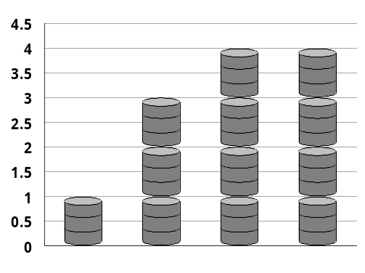


The Challenges Facing Us…
Growing Petroleum Consumption
Global
Climate
Change
Urban
Pollution
Notes:
Let me quickly summarize a few of the challenges facing us – challenges made more acute by the burgeoning demand for transporting people and goods.
Growing Petroleum Consumption – Demand for petroleum has grown steadily during the 1900s. Worldwide, petroleum demand for 1999 is expected to reach 77 million barrels per day, up from 67 million barrels per day in 1993, for an annualized growth rate of about 2 percent per year. Rapid growth among the world’s developing nations means competition may greatly increase for petroleum on the world market.
Urban Pollution – As population, numbers of vehicles, and vehicle miles traveled continue to increase, urban pollution in most of the world continues to worsen. From Bangkok to Mexico City, communities and regions are realizing the adverse impacts of pollution, much of it due to transportation. Although vehicle manufacturers have made substantial progress in reducing the emissions per vehicle – a real success story – transportation related emissions are still a major problem because of increasing population, increasing number of vehicles and corresponding miles traveled. The associated health costs are a concern to us all. [The American Lung Association estimated in 1988 that Americans spend $50 billion annually on health care resulting from air pollution. ]
Climate Change – Concentrations of carbon dioxide are 32 percent higher today than in pre-industrial levels. The rise in greenhouse gas emissions from fossil fuel combustion and industrial and agricultural activities has stimulated international concern about possible impacts of these emissions on climate.

Slide 3
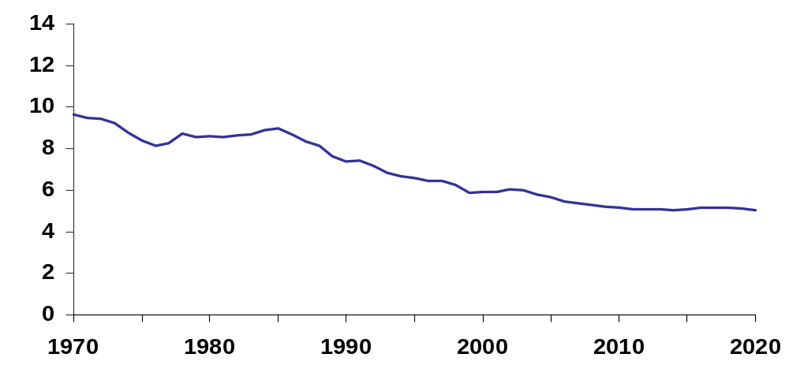

U.S. Transportation Uses More Oil Than Is Produced Domestically
Highway Carbon Emissions
(million metric tons)
1990 2000 2010 2020
325 384 455 507
Commercial Vehicles
Domestic Oil Production
Heavy Trucks
Millions of Barrels per Day
Light Trucks
Passenger Vehicles
Automobiles
Actual
Projected
Source: Transportation Energy Data Book: Edition 20, DOE/ORNL-6959, October 2000, and EIA Annual Energy Outlook 2001, DOE/EIA-0383(2001), December 2001
Notes:
U.S. oil consumption is currently more than 19 million barrels per day with about 67 percent of this total being used for transportation. The breakdown of the oil used for transportation is shown on this slide. As you can see, passenger vehicles make up a significant portion of the oil used in transportation. Reducing a portion of the oil used for passenger vehicles presents an excellent opportunity for reducing energy consumption. This in turn will reduce the nations dependence on oil imports.

Slide 4

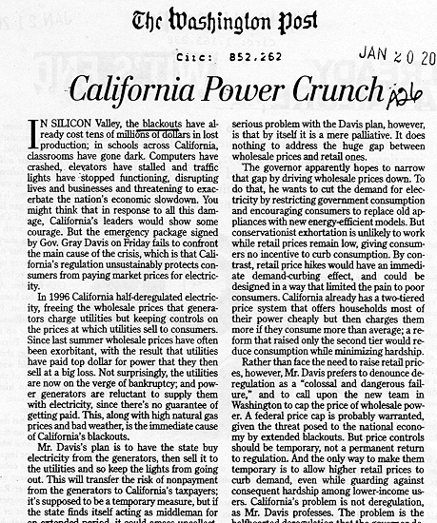
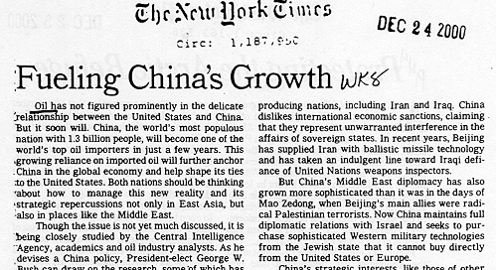
Headlines Reflect Growing Concern Over Energy Supplies
Notes:
These articles reflect the growing concern over the supply of energy and fluctuating energy prices. Certainly, the U.S. economy is directly related to energy prices. Every major oil price shock of the last 30 years was followed by a recession.
As China and other nations with emerging economies in Asia, Latin America, and Eastern Europe experience growth, they will contribute to the world’s increased demand for oil. In China, car sales are up 15% a year. In Beijing alone, the number of cars has nearly tripled to 1.6 million since 1993. (The Washington Post, March 12, 2001) This trend will surely continue.
As the worldwide demand for oil increases, competition for this resource will also increase. Even if the U.S. increased it’s domestic oil production, will it be enough to keep pace with the growth in demand? One of the highly debated exploration areas is the Arctic National Wildlife Refuge, which “holds between 5.7 billion and 16 billion barrels of recoverable reserves, with a mean estimate of 10.4 billion barrels” (Secretary Abraham quoting USGS – 3/19/01). This amount could provide fuel (at 1998 fuel consumption levels) for U.S. transportation for 3 years.
The importance of this issue requires a multi-faceted approach. The Energy Council, an organization of elected legislators from ten states, stated this in their National Energy Strategy. “Our society and our economy require reliable power, at stable prices, with ever decreasing environmental impacts…We must focus our policy efforts on conservation (maximizing the value of energy), access (to develop energy resources, improve transmission and assure generation of power) and energy technology (to improve efficiencies and lessen environmental impacts).”

Slide 5
“Sustainable Development” Approach Required
We must approach the transportation challenge from a “sustainable development” perspective.
“Sustainable development” is broadly defined as economic growth that will benefit present and future generations without detrimentally affecting the resources or biological systems of the planet.*
Government and Industry share responsibility.
*Page 149, Linking Science and Technology to Society’s Environmental Goals, Policy Division National Research Council, National Academy Press, Washington D.C. 1996
Notes:
We need to take action! Our plan should be clear: develop and produce the technologies that permit the future demand for vehicles to be met in a manner that is sustainable.
During the past year the commitment by several energy companies to voluntarily reduce the level of sulfur in gasoline, and by DaimlerChrysler, Ford, and General Motors to voluntarily produce sport utility vehicles which have emissions well below current standards, provide evidence that industry is taking these issues seriously.

Slide 6


What are we doing to meet the challenge?
Working with industry to pursue a broad range of advanced vehicle technologies
USABC
21st Century Truck
US AMP
California Fuel Cell Partnership
Advanced Clean Diesel Engine
BCI
Notes:
We believe the key to success is building partnerships which successfully integrate the different, but complementary, roles of industry and government.
We are proud of the partnerships we have established with industry.
We are now working with 80 communities in the Clean Cities Program and 3700+ registered Clean Cities stakeholders. Through partnerships among fuel suppliers, fleet operators, state and local government, and private sector organizations, we are fostering the development of alternative fueled vehicle markets in communities across the nation. More than 160 thousand alternative fueled vehicles are on the road in these communities with over 5,000 alternative fuel stations.
DOE partnered with BC International, the first plant designed to convert waste biomass to ethanol which was constructed in Jennings, Louisiana. This plant produces ethanol from sugar cane waste that was previously land-filled. An additional benefit is that we avoid the generation of greenhouse gasses from the land-fill. They are currently producing 20 million gallons per year.

Slide 7
Aggressive Timetable
Established for PNGV
1993
Candidates for Development:
Hybrid Vehicles
Fuel Cells, Fuel Reformers
CIDI Engines, Turbines
Low Emissions Technologies
New Materials
Advanced Design Simulations
Efficient Electronics and Electrical Devices
Advanced Batteries
Ultra-Capacitors and Flywheels
1997
2000
2004
Three Production
Prototype Cars
Three
Concept Cars
Focus and Accelerate
Technology
Demo. Vehicles
Technology Selection
Decisions Completed
Notes:
At the outset, an aggressive timetable was established to meet the goals of the PNGV. This timetable includes three major milestones: 1) identify the most promising technologies for meeting PNGV goals by the end of 1997, 2) develop concept vehicles by the end of 2000, and 3) develop production prototype vehicles by the end of 2004.
During the first four years of the PNGV program, USCAR and the government research managers examined hundreds of possible technologies. At the end of calendar year 1997, the most promising technologies for the Goal 3 concept vehicles were selected. The concept vehicles have been delivered to DOE.

Slide 8
Technology Portfolio Continues to Evolve
Engine/Power Sources
Advanced Heat Engines
  DI Engines
  HCCI
  VCR
Combustion and Aftertreatment
  Lean NOx Catalyst
  EGR
  Traps
Fuel Cell
Batteries
  NiMH Battery
  Lithium Battery
Pneumatic/Hydraulic Storage
Power Electronics
  Invertors/Controllers
  Motors
  Ultracapacitors – Electric
Systems Development
Aerodynamics
Rolling Resistance – Tires
Accessory Loads – HVAC
Powertrain Configuration
  Parallel HEV
  Series HEV
Fuels Utilization
Gasoline
Diesel Fuels and Blends (<15 ppm sulfur)
Natural Gas
  Methanol
  Fischer-Tropsch
Ethanol
Hydrogen
Advanced Materials
Lightweight Materials
  Aluminum/Composite BIW
  Composite BIW
Propulsion Materials
Most promising options
Other technologies
Notes:
As you can see, the program focuses on the entire vehicle system.
In the following slides I will go into greater detail on the advantages and research status of these technologies.

Slide 9
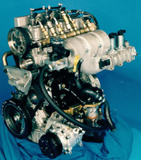
Why is CIDI of Interest for Hybrid Vehicles?
High peak thermal efficiency (greater than 40% for light-duty engines) and wide operating map at good thermal efficiency.
Low cold-start/restart emissions and rapid restart capability (key issue for hybrid powertrains with frequent restarts).
Wide operating range appropriate for direct-drive, parallel-hybrid, and series-hybrid powertrains.
Demonstrated affordability (but higher cost
than conventional gasoline engines).
High-volume manufacturing technology well
understood.
Maturity consistent with PNGV program schedule.
Notes:
CIDI engines are very promising from a thermal efficiency point of view however, emissions remain a very serious barrier and is the focus of the research underway. In addition, cost is another barrier to be overcome.
The first examples of diesel engines for automotive applications are now beginning to be seen in the marketplace. For example, Volkswagen offers a 1.9L diesel in the new Beetle. I have had the opportunity to drive these new diesels and they are not the diesels of the past - they have good pickup, no noise, and no smoke.
DOE and its industry partners have developed two different CIDI engines for hybrid propulsion systems. SIDI engines are also under consideration.

Slide 10
Fuel Cells
Single Fuel Cell
Fuel Cell Benefits
  Efficiency
  Emissions
  Economic
OXYGEN
HYDROGEN
e -
e -
e -
O₂
H+
O₂
Fuel Cell Types
H+
H+
H+
O₂
Proton Exchange
Membrane (PEM)
Alkaline
Phosphoric Acid
Molten Carbonate
Solid Oxide
Bipolar Plate
Bipolar Plate
Cathode +
Anode -
Electrolyte
Platinum Catalyst Electrodes
Notes:
Fuel cells offer the low-to-no emissions, fuel flexibility, and high efficiency. Proton exchange membrane fuel cells are being pursued for automotive applications.
At the beginning of PNGV, the automobile companies were ready to take fuel cells off the table — as they were seen to be very long-term. However, recent announcements (Ford, GM, Ballard-Mercedes) indicate that automobile companies perceive fuels cells to be a very strong propulsion system candidate. In the past several months, several automobile manufacturers have publicly released statements indicating their commitment to fuel cell technology and highlighting several recent accomplishments.
DaimlerChrysler AG introduced the NECAR 4. At the introductions ceremony, Jurgen Schrempp (DaimlerChrysler’s chairman) said that the race to develop the fuel cell car is over, that now we begin the race to lower the cost to the level of today’s ICE.
Interestingly, DaimlerChrysler and Ford each own a share of Ballard, and Nissan and Honda have ordered Ballard fuel cells.

Slide 11
Technology Research Status
Hybrid Systems: Parallel configuration offers best option to meet 80 mpg. Series configuration may be used with fuel cells. Cost, weight, and packaging remain as challenges.
CIDI Engines: Mature technology with 44% efficiency, but NO_{x} and particulate emissions remain as challenges.
Fuel Cells: Lowest onboard emissions and potential for highest efficiency, but cost, systems integration, and fueling infrastructure are major challenges.
Energy Storage: Considerable progress in developing high-power battery; focus now on cost and cycle life.
Power Electronics: Progress on cost, power-to-weight ratios, and efficiencies continues
Light Materials: Significant weight reductions achieved. Major issues are cost, manufacturability, joining, recycling, and repair.
Fuels: Next generation of clean fuels is needed. Implications on infrastructure must be addressed. Evaluation continues on the effects of fuel composition and physical properties on engine performance and exhaust gas emission control efficiencies.
Notes:
Here is a laundry list of the status of each of these technologies that are being pursued by PNGV. The next few slides will highlight some of the research and accomplishments of some of these technologies.

Slide 12
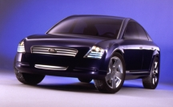
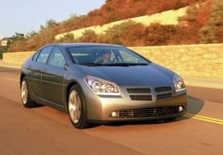
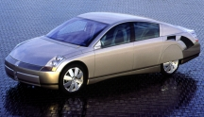
2000 PNGV Concept Vehicles
Ford Prodigy
Lightweight materials reduce vehicle body structure weight 50%*
Integrated starter/alternator*
33% reduction in aerodynamic drag
Advanced diesel engine with 35% efficiency improvement projected to exceed 70 mpg (gasoline equivalent)*
High-power battery *
DaimlerChrysler ESX3
Body system weighs 46% less*
Efficient diesel engine, motor, and battery projected at 72 mpg (gasoline equivalent)*
Cost penalty halved to $7500
GM Precept
Vehicle body weight reduced 45% *
World’s most energy efficient vehicle lighting system
Lowest drag coefficient ever recorded for a 5-p sedan
Dual-axle parallel hybrid achieves 79.6 mpg (gasoline equivalent)
*Government supported technologies
Notes:
Explain gasoline equivalent
PNGV achieved its second major program milestone early in 2000 with the unveiling of the 2000 PNGV Concept Cars – DaimlerChrysler’s ESX3, Ford’s Prodigy, and GM’s Precept. The Concept Cars demonstrate the technical feasibility of combining advanced technologies in vehicles to achieve up to 3X fuel economy. As such, they include components for which validated manufacturing processes and affordability have not been demonstrated. While each manufacturer has taken a somewhat different approach, each PNGV Concept Car incorporates key technologies identified in the 1997 Technology Selection.

Slide 13



Notable PNGV Technology Migration
Hybrid-electric drives scheduled for
  Dodge Durango in 2003,
  Ford Escape in 2003,
  Chevrolet Silverado in 2004,
  Ford Explorer in 2005
412 pounds of lightweight aluminum in the 2000 Lincoln LS
Aluminum used for door, deck, and hood panels for Cadillac, Oldsmobile, and Chevrolet vehicles
50-pounds lighter composite pickup truck box on the 2001 Chevrolet Silverado
Production of a new, lighter, recyclable thermoplastic hardtop for the Jeep Wrangler in 2001
Notes:
As you can see in this slide, PNGV technologies are migrating into U.S. vehicles. These technologies will potentially make the fleet of U.S. vehicles more competitive in the marketplace, while at the same time use revolutionary technologies that will make the vehicles more fuel efficient and cleaner.
DaimlerChrysler estimates that if all SUVs sold in the U.S. got a 20% increase in fuel economy (which is the % increase that the Dodge Durango gets), we would save 142 million gallons of gas a year.
The thermoplastic hardtop uses a process that has the potential to improve fuel economy and cut vehicle body weight up to 50%, it also could reduce body tooling costs by up to 70%.

Slide 14
PNGV Technologies
Are Near To Market
GM has announced that it will offer hybrid-electric drives using its hybrid ParadiGM system on cars and SUVs beginning in 2004. GM says it could be selling over 100,000 such HEVs by 2010 depending on consumer acceptance.
USCAR Mileposts magazine stated that the trend of alternatively powered vehicles, although slow, will continue with “hybrid electrics seizing almost seven percent (of the marketplace) by 2020”.
J.D. Powers provided the following estimates at the 2001 North American International Auto Show:
  By 2004, at least 8 different HEV models will be available in the U,S. (both car, truck and SUV).
  By 2005, as many as 10-15 HEV models will be available in the U.S (again cars are included)
Notes:
GM has announced that it will offer hybrid-electric drives using its hybrid ParadiGM system on cars and SUVs beginning in 2004. GM says it could be selling over 100,000 such HEVs by 2010 depending on consumer acceptance.
USCAR Mileposts magazine stated that the trend of alternatively powered vehicles, although slow, will continue with “hybrid electrics seizing almost seven percent (of the marketplace) by 2020”.
J.D. Powers provided the following estimates at the 2001 North American International Auto Show:
By 2004, at least 8 different HEV models will be available in the U,S. (both car, truck and SUV).
By 2005, as many as 10-15 HEV models will be available in the U.S (again cars are included)

Slide 15
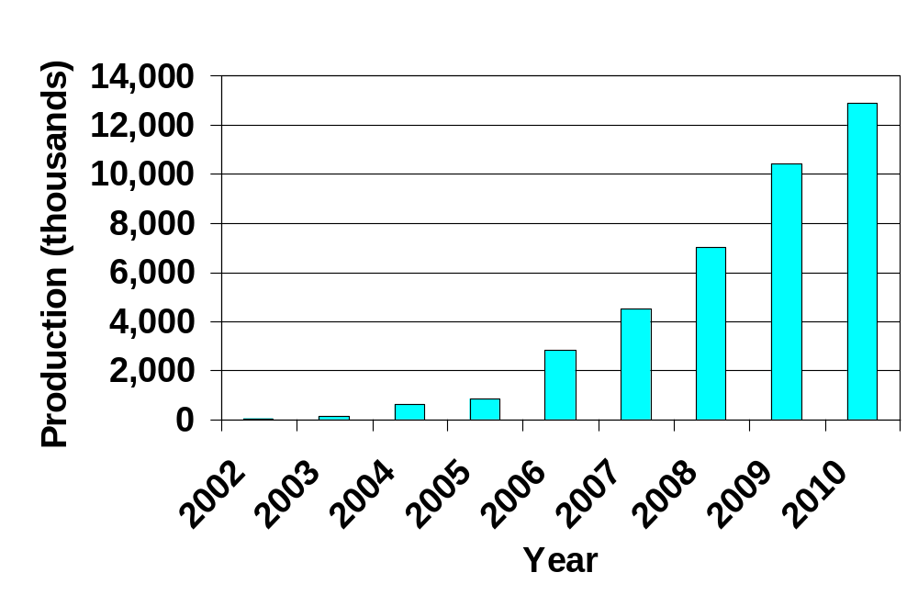
Standard & Poor's Forecast of Global Production of Vehicles with 42-V Systems
Notes:
42-V systems will enable integrated starter-generators and mild hybrids. The advantages are increased fuel economy and the ability of 42-volt systems to run accessories. It also allows the use of a smaller engine.
Challenges that remain for the 42-V systems are the tendency of 42-V systems to arc more than in the traditional 14/12-V system. This generates temperatures greater than 1832° F; it can melt metal or burn plastic; and can ignite fuel vapors. There is no supplier base for 42-V systems, so parts are expensive and the system also requires tighter manufacturing tolerances.
Standard & Poor conducted a worldwide study among vehicle manufacturers and suppliers and concluded that the more-powerful systems would pay for themselves by enabling fuel-consumption savings of 10% or more with no capital investment.
Standard & Poor’s expects that 42-V will become a self-supporting phenomenon. The benefits the higher voltage provides will become prerequisites to satisfying market demand for improved comfort and convenience and regulatory requirements for reduced emissions and fuel consumption.

Slide 16
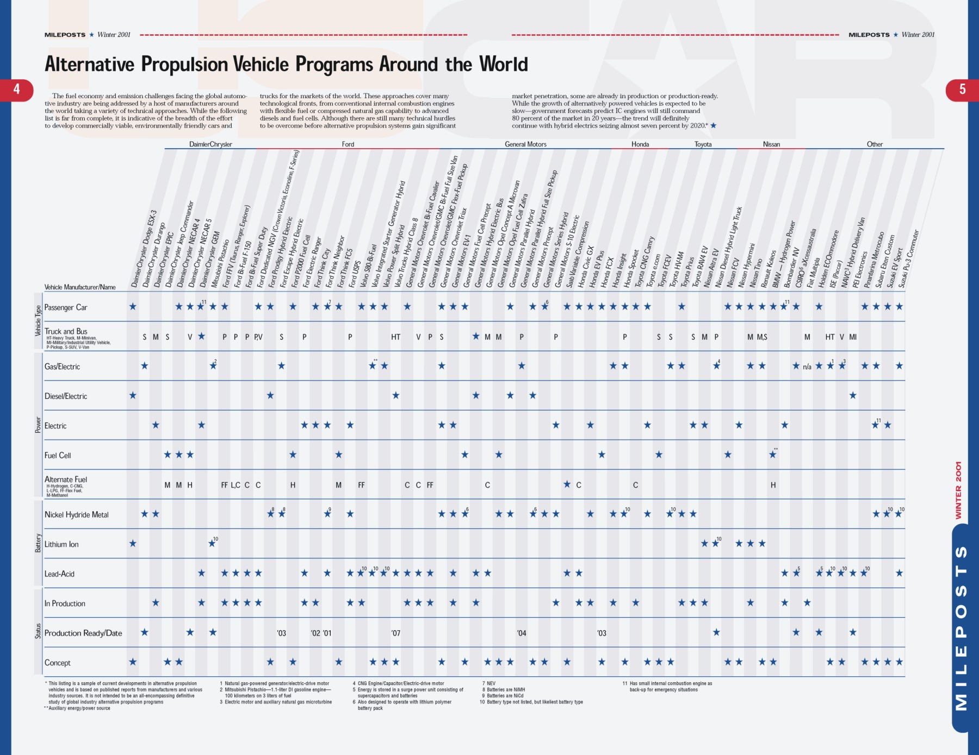
Source: USCAR Mileposts, Winter 2001
Notes:
The U.S. is not the only government that is involved in the development of these new vehicle technologies. Governments around the world are participating in research to develop higher-efficiency, lower-emissions vehicles. Notably, Honda and Toyota have both brought their hybrid vehicles to the marketplace.

Slide 17
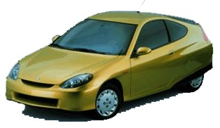

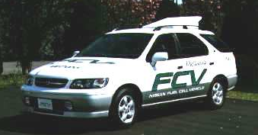
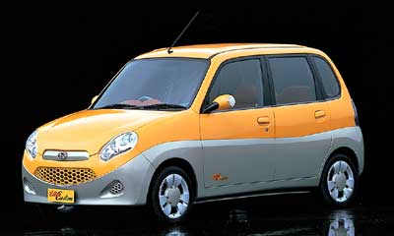
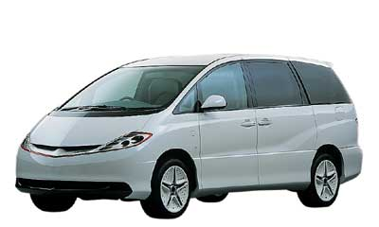
International Landscape of
Advanced Vehicle Technologies
PNGV has spurred the development of advanced automotive transportation worldwide.
These advanced technologies are being developed with government support.
  Both Honda and Toyota have received considerable Japanese tax credits and subsidies for the Prius and Insight
Manufacturers pursuing different technologies and approaches – conventional engines with flexible fuel capability to advanced diesels and fuel cells.
Over 30 concepts have been displayed worldwide.
Honda Insight
2-passenger
Fuel economy: 64 mpg (combined) -- 1.8x improvement over the 1997 del Sol (manual)
Toyota Prius
4-passenger (Corolla sized)
Fuel economy: 48 mpg (combined) – 1.3x improvement over the Corolla
Nissan Fuel Cell Effort
Announced New Fuel Cell Effort
$720 million USD (1/17/01 date of exchange) over 5 years
Subaru Concept
Elten Custom
Toyota Concept HV-M4

Slide 18
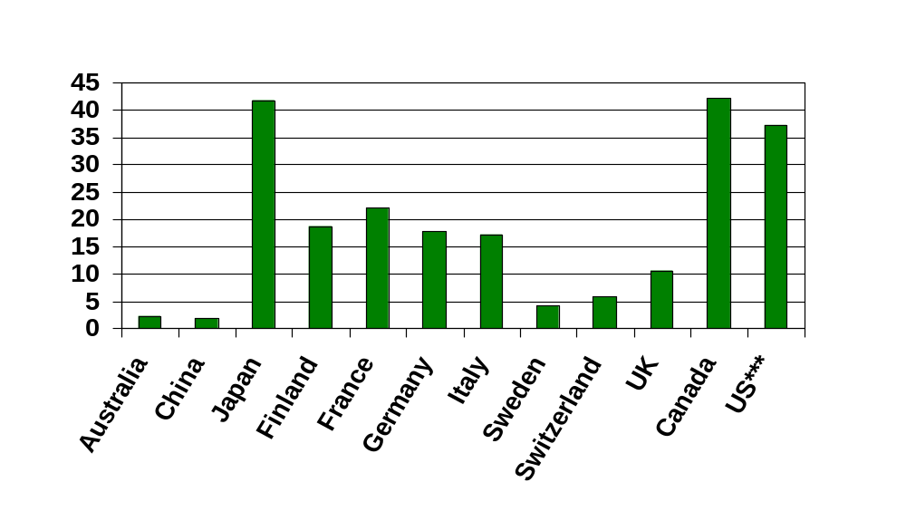
Average Annual Government Clean Energy Vehicle* Investment Per Million Gross Domestic Product**
$/million GDP
* Clean Energy Vehicles are vehicles that have increased fuel efficiency, use
alternative fuels, or have reduced emissions.
** All GDP’s used were from 1997.
*** Federal Government PNGV plus EV funding
Source: Analysis of International Automotive Research and Development, Summary Report, CSMI, January 2001
Notes:
The U.S. is not the only government that has recognized the need for government involvement in research.

Slide 19
Criteria for Ultimate Success of the PNGV Program
The vehicles must be economically viable and marketable without long-term subsidies from government or industry.
Large volume sales of advanced technology vehicles.
PNGV technology needs to proliferate throughout the entire range of vehicles, particularly in those segments with the greatest sales opportunity.
The technology should have global application.
Pursuit of revolutionary advances in technology for fuel-efficient vehicles must continue to drive the R&D program.
Maintaining the Partnership remains the path for accelerated improvements in technology and their introduction into the market
Notes:
PNGV was created as a framework for government-industry cooperation and has promoted accomplishments beyond what the parties could have done independently. The PNGV Program’s success will ultimately be determined not by production of a particular vehicle, but when the these indicators have been achieved:
• Large numbers of PNGV vehicles must be sold. Production of a few thousand “green” vehicles will achieve insignificant gains in reduction of national fuel usage or emissions, including greenhouse emissions.
• PNGV technology must proliferate throughout the entire range of vehicles, with resulting fuel economy improvement. While 3X will not be achievable throughout the range, the fuel savings will still be significant.
• The vehicles must be economically viable and marketable. Otherwise companies producing them cannot compete. Nor can government subsidies continue to be used to support “green” technology without impacting the national economy.
• The technology must be applied worldwide. Worldwide fuel usage and pollution are increasingly determined outside the borders of the United States.
The limits of the technology are far from being reached. Significant gains in lowering fuel consumption and reducing emissions depend on quantum jumps in technology like those from the PNGV program, rather than incremental advances. Currently, with a long-range view in mind new areas of cooperation are being identified to further accelerate the revolution in personal transportation systems.

Slide 20
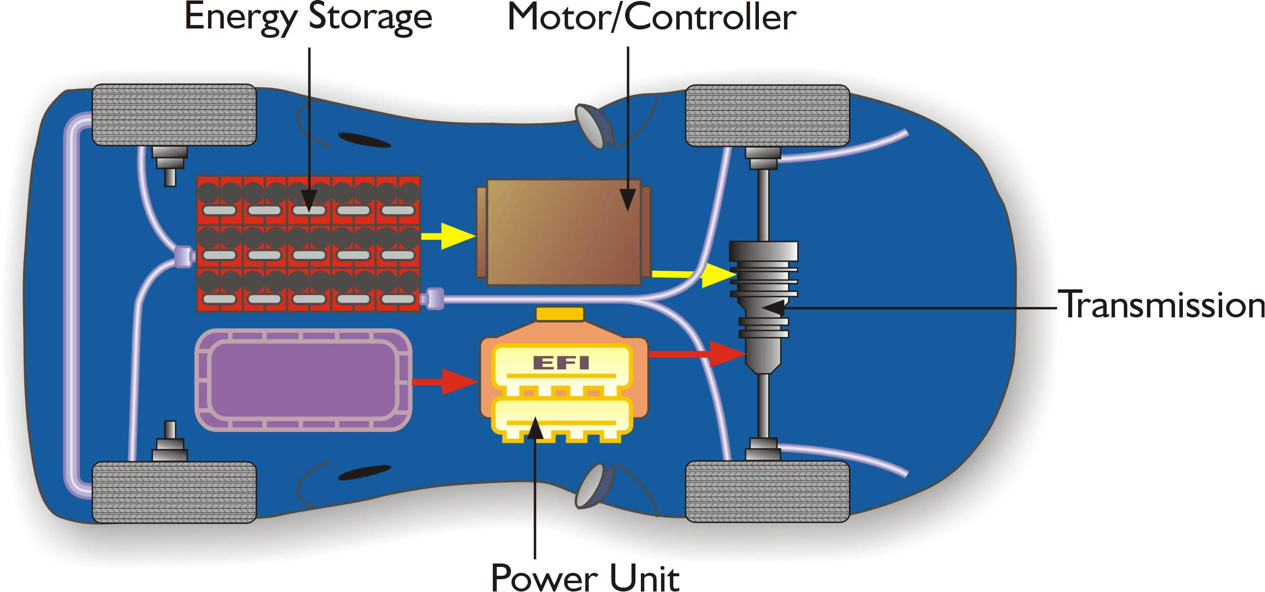
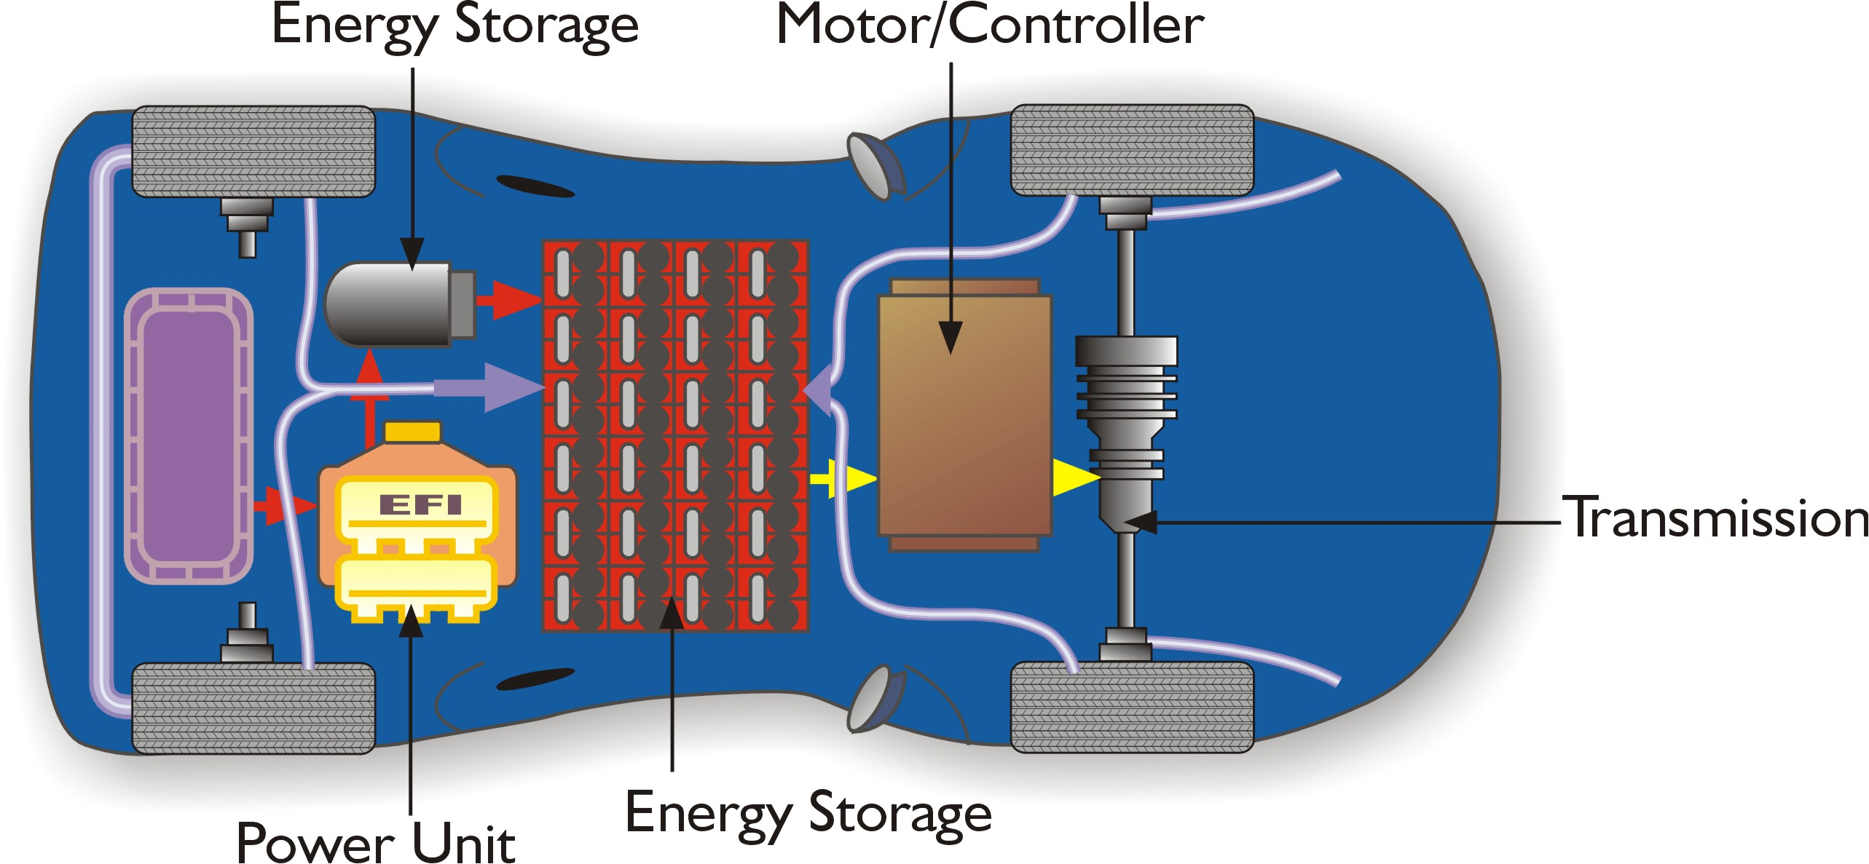
What Is a Hybrid Vehicle?
A vehicle that uses two power sources: energy conversion device and energy storage device
  Fuel cells, diesels, lean burn gasoline engines, or traditional gasoline engines can be used as the energy conversion device
  Batteries, flywheels, or ultracapacitors can be used for energy storage
Parallel Configuration
Series Configuration
Notes:
A hybrid vehicle uses two power sources: energy conversion device and energy storage device
Fuel cells, diesels, lean burn gasoline engines, or traditional gasoline engines can be used as the energy conversion device
Batteries, flywheels, or ultracapacitors can be used for energy storage
The technologies being developed for hybrid vehicles are being designed to accommodate a variety of fuels.
Parallel Hybrid Vehicle:
Both hybrid power unit and electric motor can drive wheels simultaneously or separately
During acceleration or hill climbing both power sources can be used
While cruising, just the hybrid power unit (HPU) can be used
Series Hybrid Vehicle:
Power unit with generator supplies electricity to the battery pack and electric motor
Only the electric motor drives the wheels
R&D is focusing on removing cost, weight, and packaging barriers.

